Slide 1

Restaurant Database Management System
IT 530 Group Project – Dr. Carol Jim
Lavan Gujjula
Neha Prasad
Chiranjibi Ghimire

Slide 2
Overview
Relational Database Management System for the management of multiple restaurants
How can a business owner or manager operate profitable restaurants efficiently?
How can technology provide transparency and agility?

Slide 3
PROPOSED SOLUTION
Restaurant database management system that is efficient, user-friendly and informative
Efficient - has the capability to take multiple orders, calculate order total, display bill paid by a customer, manage staff and a customer portal that holds demographic information
User-friendly - easy to use and navigate for staff, managers and owners
Informative – food safety news, such as the recent E. Coli outbreak, information on specific situations, example - extended menu for specific food allergies

Slide 4
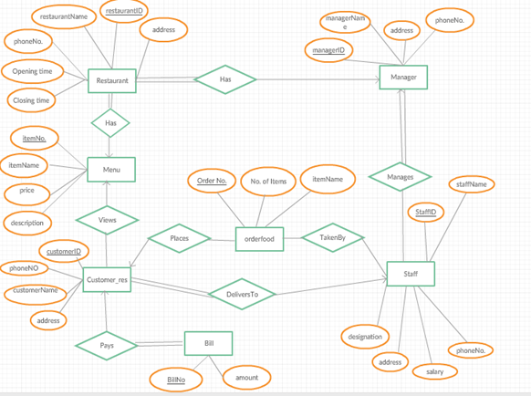
Entity relationshipdiagram

Slide 5
Strengths & weaknesses
STRENGHTS
Efficiency, user-friendly and informative
Simple design but also can be customized
Capability of displaying promotional items and customer contacts can be used for marketing and advertising
WEAKNESSES/Challenges
Increase quality assurance of the system to add functionality

Slide 6
Demo
http://pluto.hood.edu/~lg13/index.html

